Slide 1
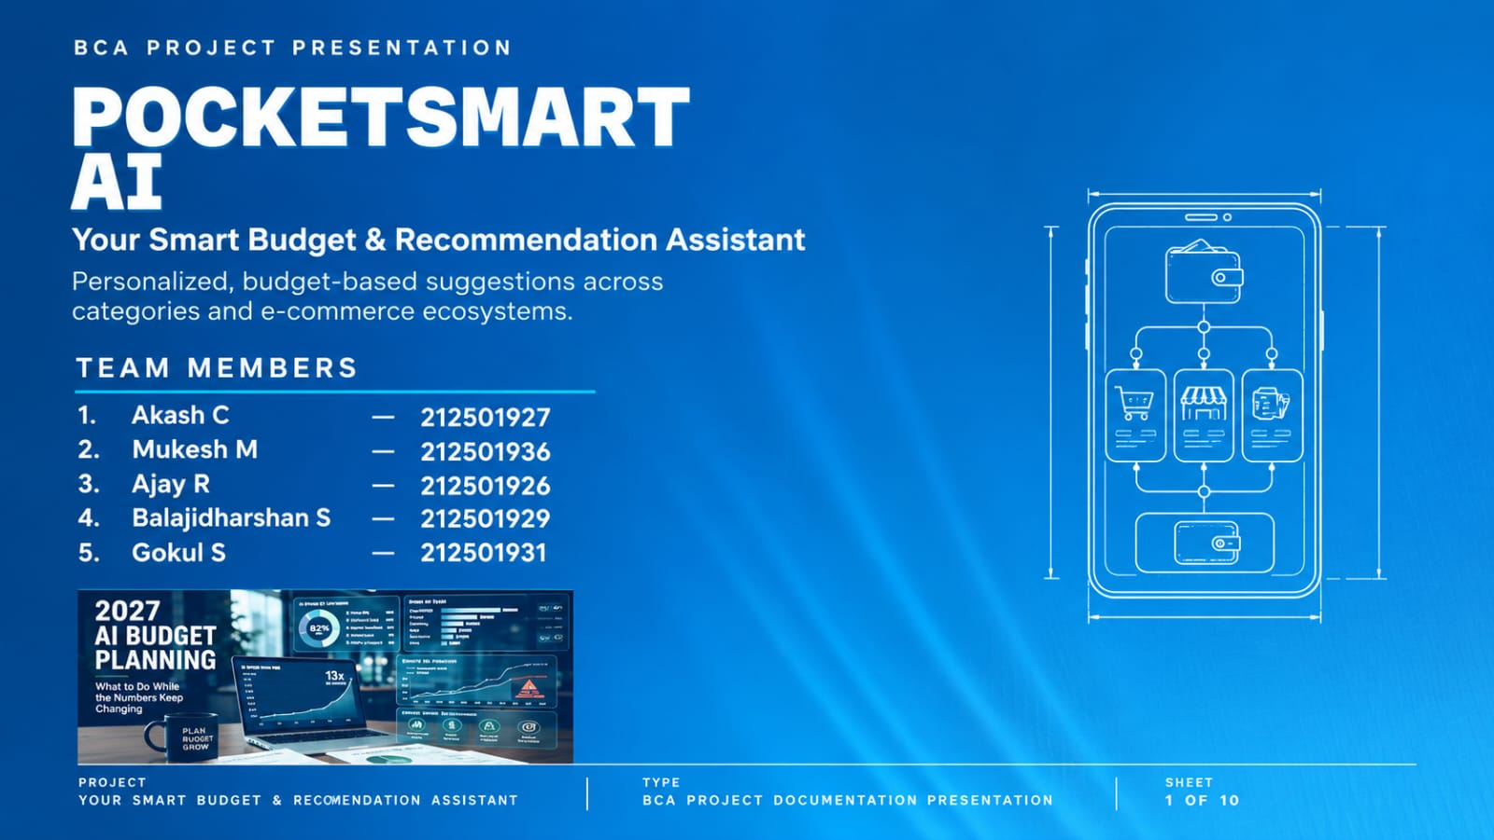
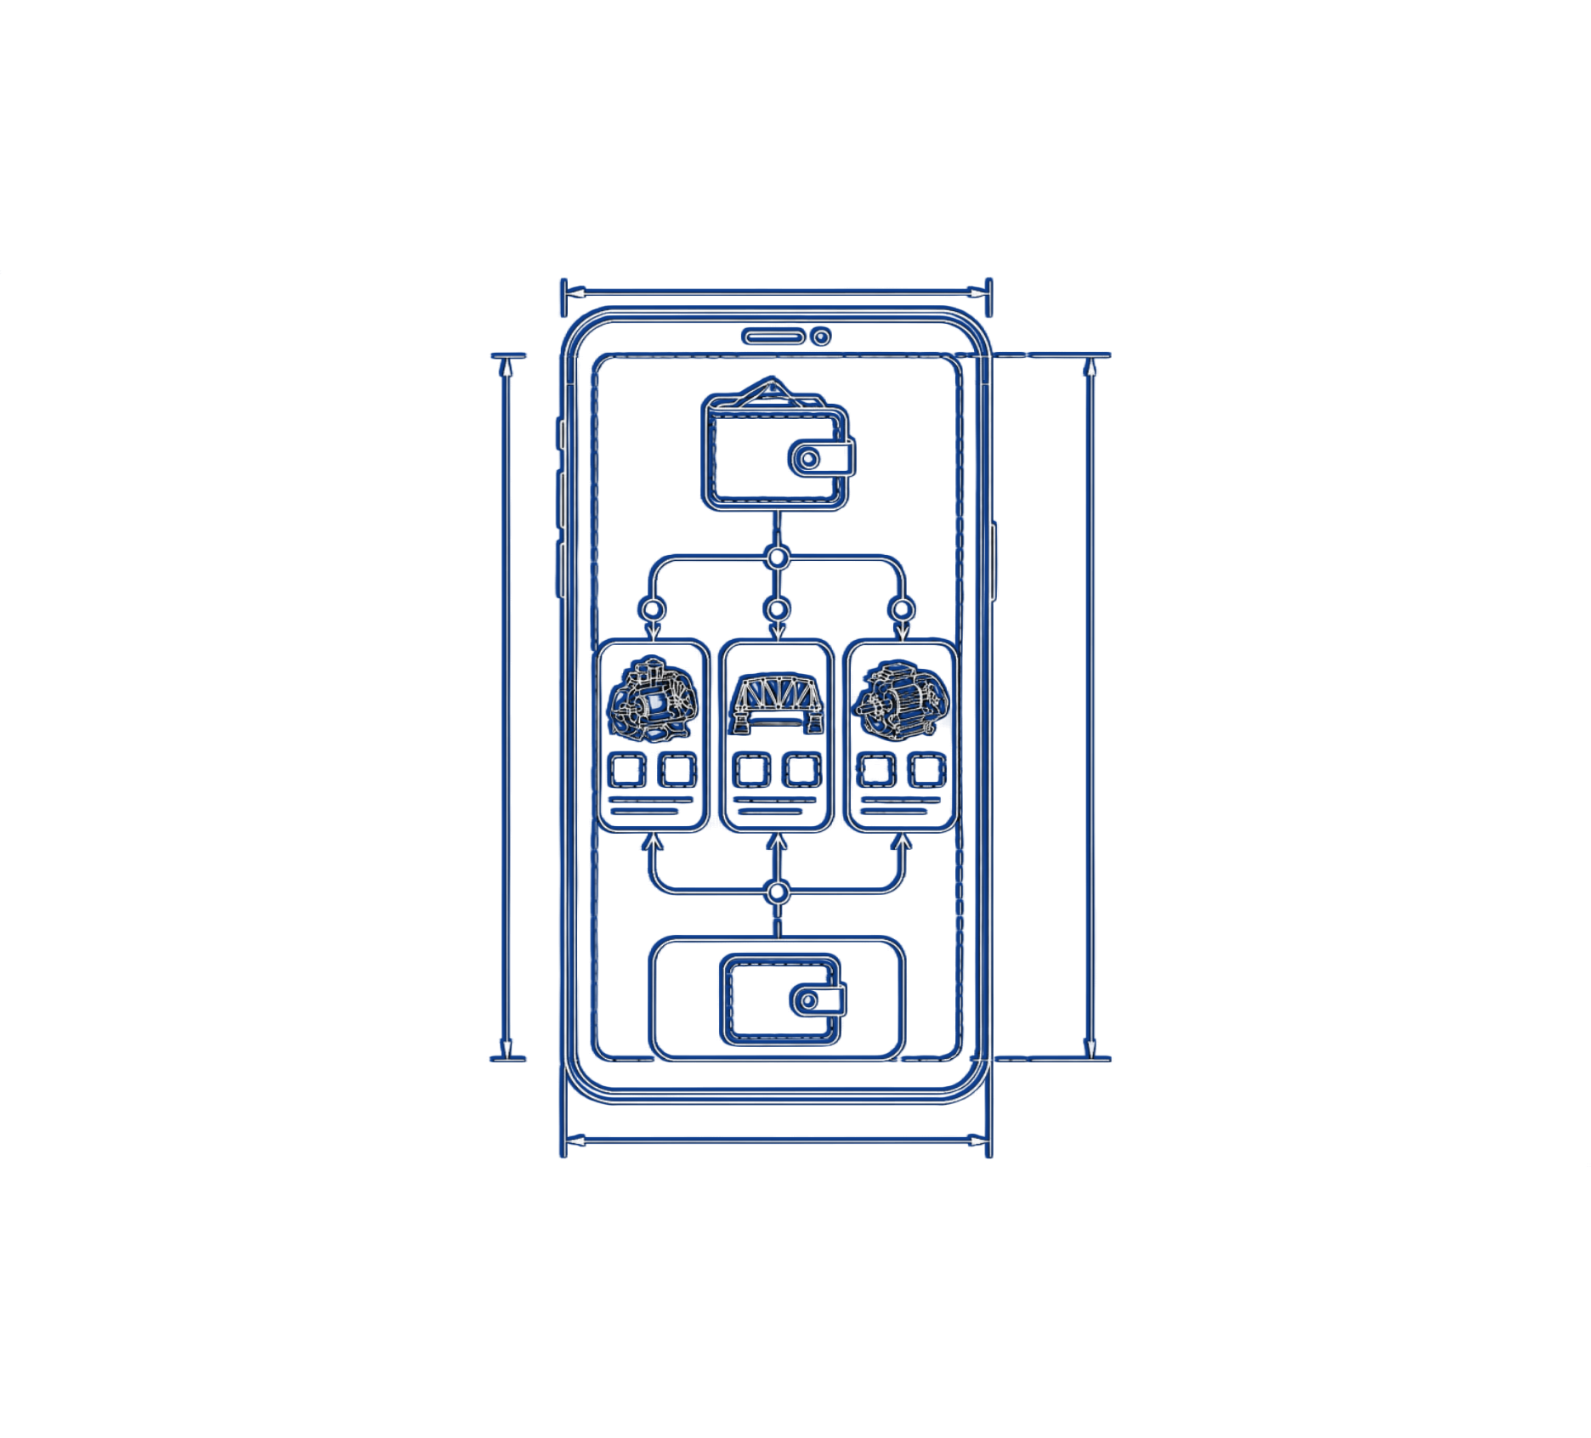
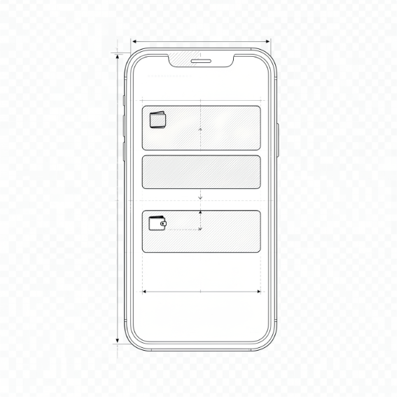
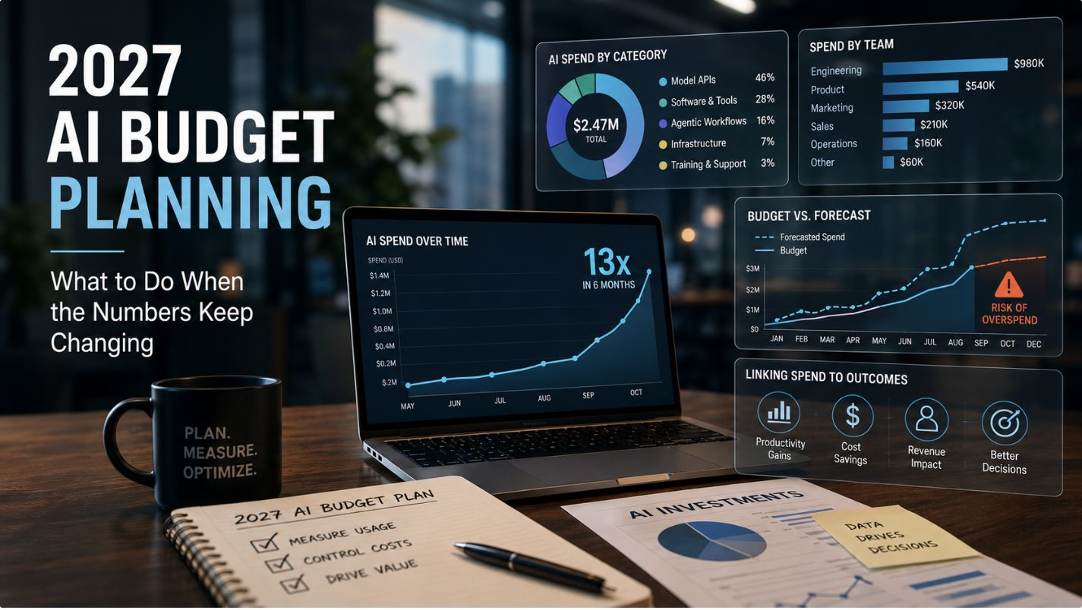
POCKETSMART AI
PROJECT
TYPE
SHEET
YOUR SMART BUDGET & RECOMMENDATION ASSISTANT
PocketSmart AI
BCA documentation
1 OF 10
BCA Project Documentation Presentation

Slide 2
PROJECT INTRODUCTION
Planning home décor, events, and jewelry can be difficult across many products, platforms, and price ranges.
01
PocketSmart AI uses budget and preferences to shape personalized, cross-platform recommendations.
02
Three focused planners support home interiors, parties, and occasion jewelry.
03
02 / 10

Slide 3

POCKETSMART AI TURNS A BUDGET INTO A PLAN
Users provide a budget and contextual preferences; the system interprets the request and returns curated suggestions suited to their needs and selected category.
Gemini 1.5 Flash Pro is described as the recommendation and multimodal analysis layer.
USER INPUTS
GEMINI 1.5 FLASH PRO
CURATED RECOMMENDATIONS
03 / 10

Slide 4



THREE PLANNERS ADDRESS DISTINCT LIFE NEEDS
Home Interior
Party
Jewelry
Rooms, quantities, furnishings, décor, and lighting.
Event type, guests, venue, catering, decoration, and entertainment.
Budget, occasion, style, and optional outfit image.
04 / 10

Slide 5


HOME INTERIOR PLANNER: ALLOCATE ROOM BY ROOM
SELECT PLANNER
Select the Home Budget Planner and enter the total budget.
RECOMMENDATION LAYER
SPECIFY ROOMS
Gemini recommends cost-effective options across platforms such as IKEA and Amazon, balancing function, style, and price.
Specify room types, such as living room, kitchen, and bedroom.
ENTER QUANTITIES
Enter item quantities for lights, ceiling fans, dining tables, and similar needs.
05 / 10

Slide 6
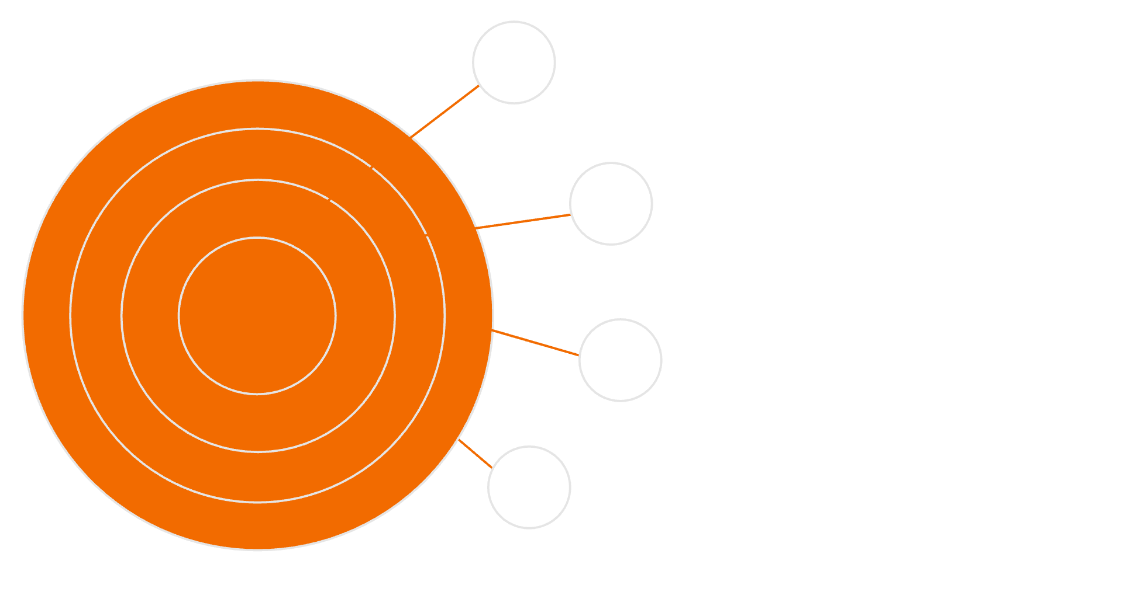




PARTY PLANNER: DISTRIBUTE SPEND BY EVENT NEED
INPUTS
INPUTS
Total budget, guests, event type, venue.
Total budget
Guest count
Event type
Venue details
ALLOCATION
AI splits budget for catering, decor, entertainment.
RECOMMENDATIONS
CONTEXTS
Swiggy, Zomato options and OYO stays.
Birthday, corporate, and wedding contexts tailor recommendations.
LOGISTICS
Venue details and vendor coordination plan.
06 / 10

Slide 7





JEWELRY PLANNER: MATCH OCCASION, STYLE, AND BUDGET
Enter a budget, occasion, and style preferences.
Optionally upload an outfit image for color coordination and aesthetic context.
Example product platforms: Amazon and Flipkart.
STYLE & OCCASION
BUDGET
GEMINI MATCHES
OUTFIT IMAGE
07 / 10

Slide 8
PART 2 · SYSTEM DESIGN
ARCHITECTURE & TECHNOLOGY
From browser input to personalized recommendation

Slide 9

ARCHITECTURE OVERVIEW
SYSTEM POSTURE
USER INTERFACE
Inputs move through a modular flow: interface, backend, Gemini AI layer, and rendered recommendation.
Optional image input is relevant to jewelry planning.
Third-party platform data may be sourced or simulated, depending on the implementation section.
BACKEND ROUTING
GEMINI 1.5 FLASH PRO
RECOMMENDATION RENDER
09 / 10

Slide 10
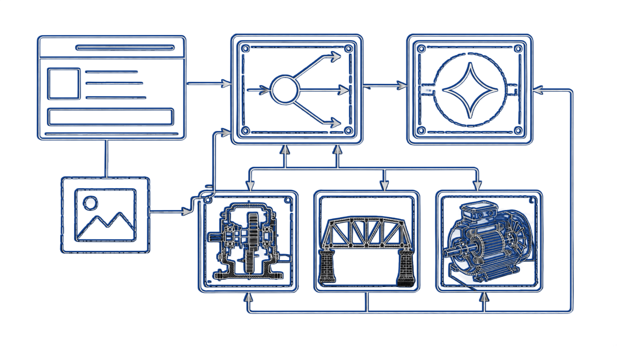
COMPONENT-WISE ARCHITECTURE
Frontend UI
01
Collects budget, preferences, and images; displays tailored recommendations.
Backend
02
Routes requests, connects the interface to Gemini, and manages sessions.
Gemini AI layer
03
Interprets text, numbers, and images; generates structured suggestions.
External platforms
04
Product and service examples include Amazon, Flipkart, IKEA, Zomato, and others.
10 / 10

